Slide 1

Practical examples of accelerating numerical and ML research with Julia
Jamie Mair
Final Year PhD
School of Physics & Astronomy

Slide 2
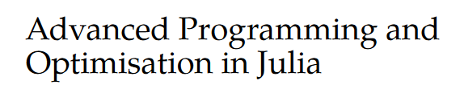
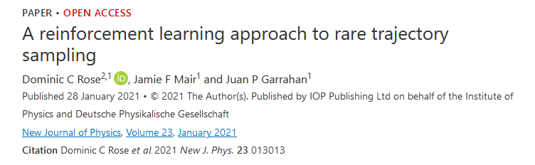
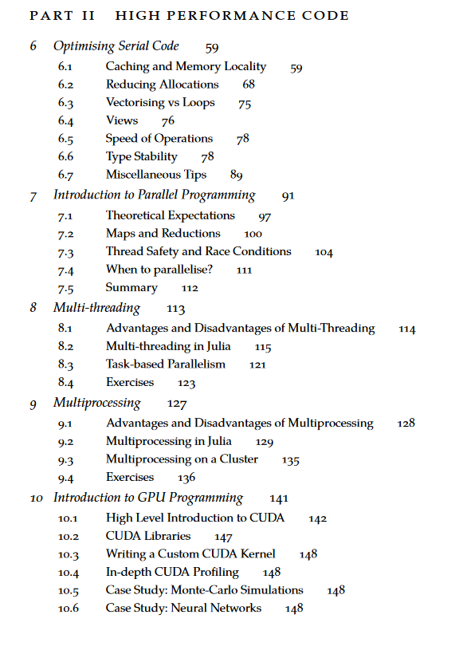
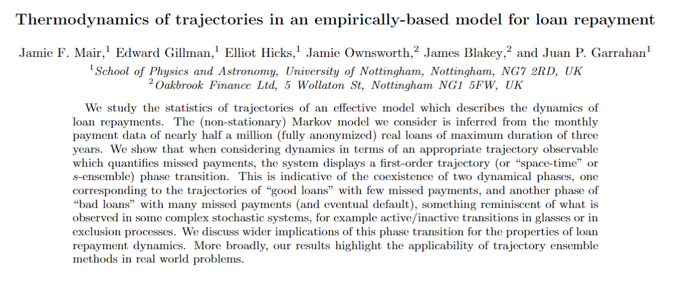
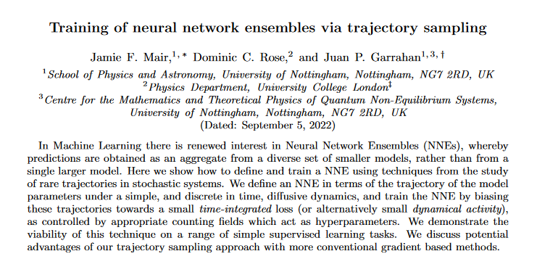

What do I do?
Notes:
Work is at the interface between Machine Learning and Statistical Mechanics
Reinforcement Learning with rare trajectory sampling -> translates a large deviation problem into a reinforcement learning problem. RL requires an interative process of generating simulation data with a model and then processing and training on that data. Can require 10s of millions of epochs, with each epoch requiring hundreds of thousands of calculations. This is then usually repeated many times.
Using machine learning models with transition path sampling, which need to run for a long time, and many repeats to study a spectrum of a parameter.
Some external work with a finance company, applying machine learning methods to real world data.
Some other work, such as applying reinforcement learning in quantum circuits.
Working on a postgraduate level “MPAGS” model which focuses on teaching a basic level of high performance computing to new PhD/Masters level students using Julia
Most of the techniques applied require a large scale to work, and to research. One needs to often see how a system behaves under varying parameters, involving a lot of randomness, so most results require large numbers of repeats. Most applications need to be able to scale to run on a cluster or at least a GPU. Most code is custom, and does not always have a package that will do what you want.

Slide 3
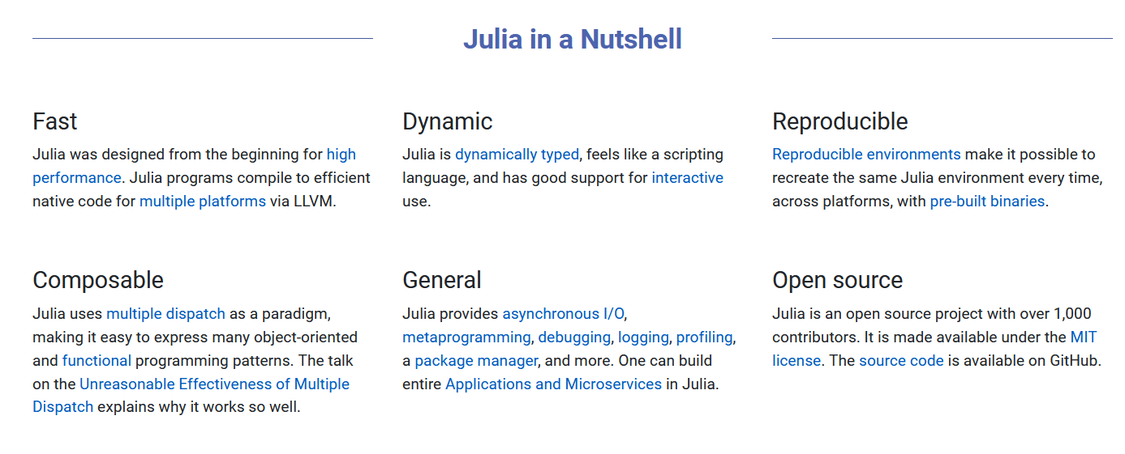
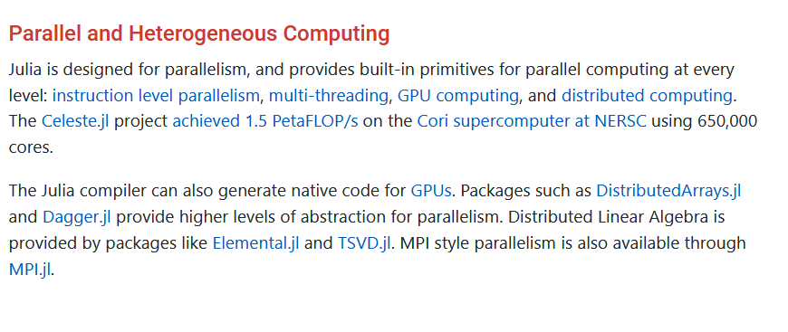

What is Julia?
https://julialang.org/

Slide 4
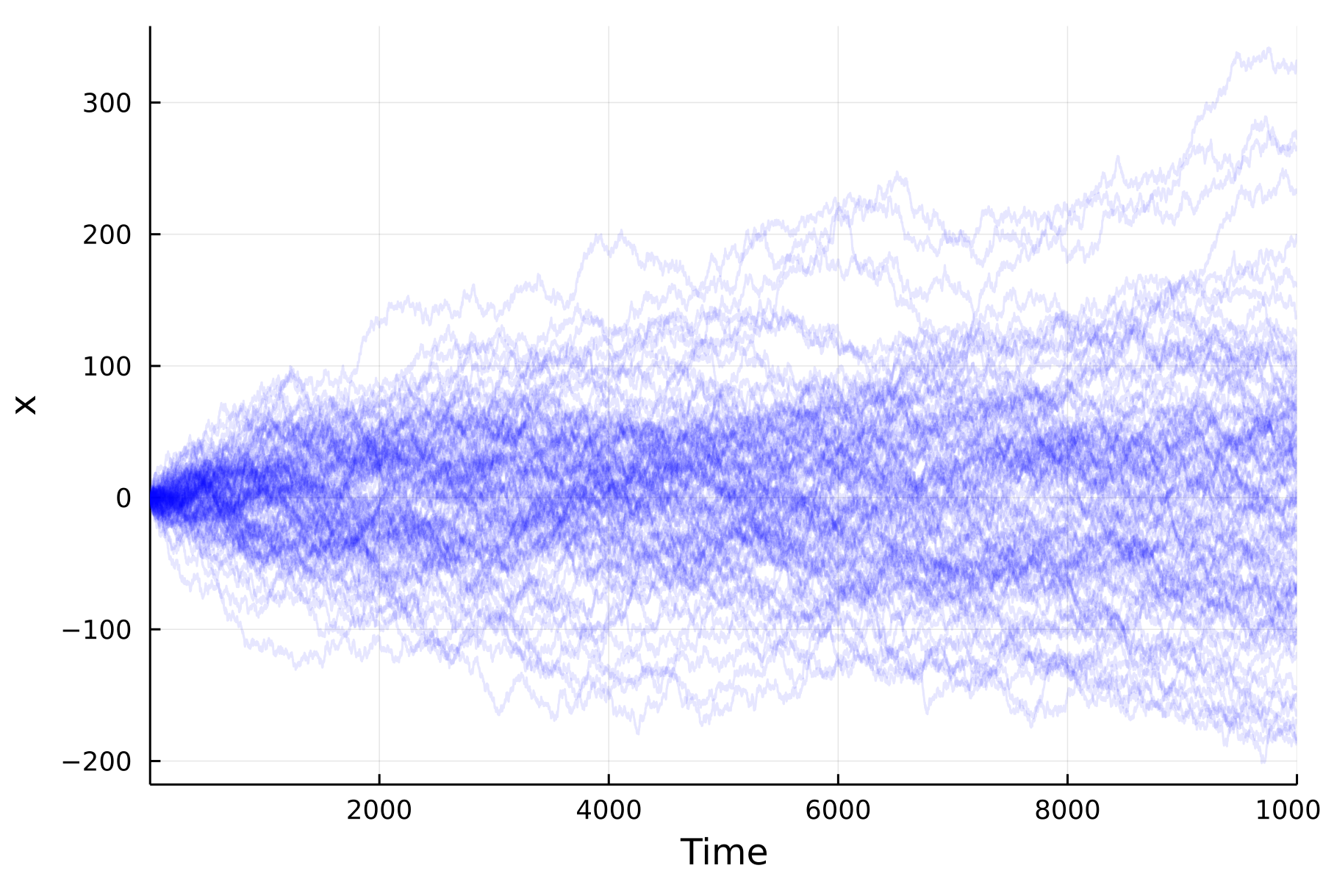
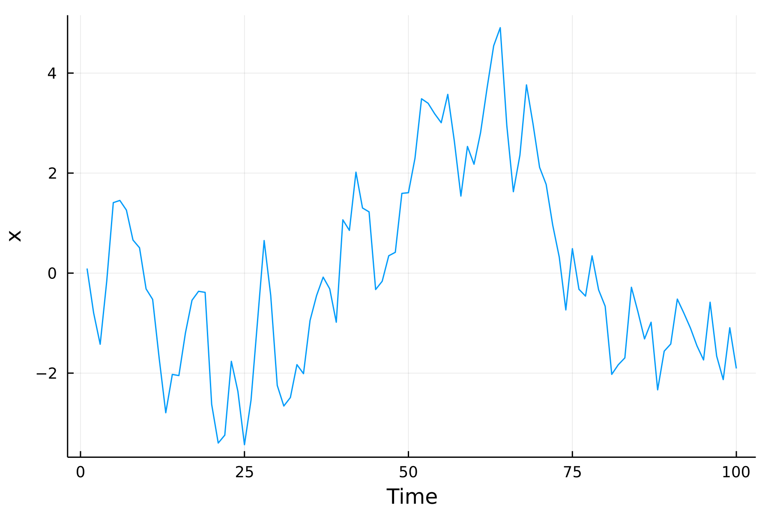
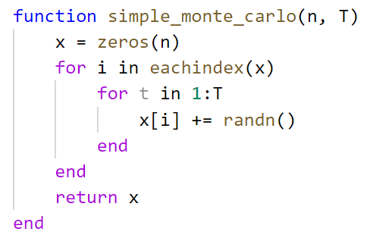
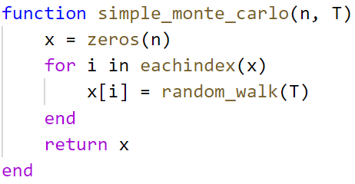

Example Problem – Monte Carlo Simulation
Random walk of a single particle over a number of discrete time steps.
We want to generate $n$ samples of the final position of the walk after $T$ time steps.
Most Monte-Carlo simulations are “embarrassingly parallel”
Generic independent function

Slide 5
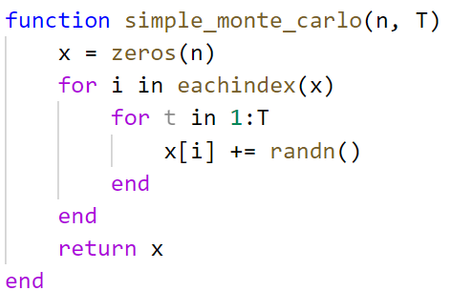
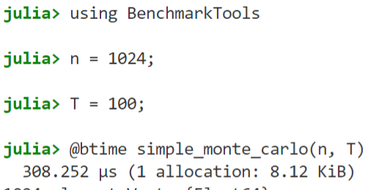
Code Overview + speed
# Allocates an array with n elements
# Iterate through all indices of the array
# Loop over all time steps (T)
# Add a Gaussian random number to the element
# Return the array

Slide 6
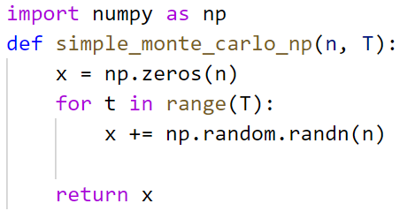

Is it fast? (vs numpy)
~7 times faster in Julia****

Slide 7
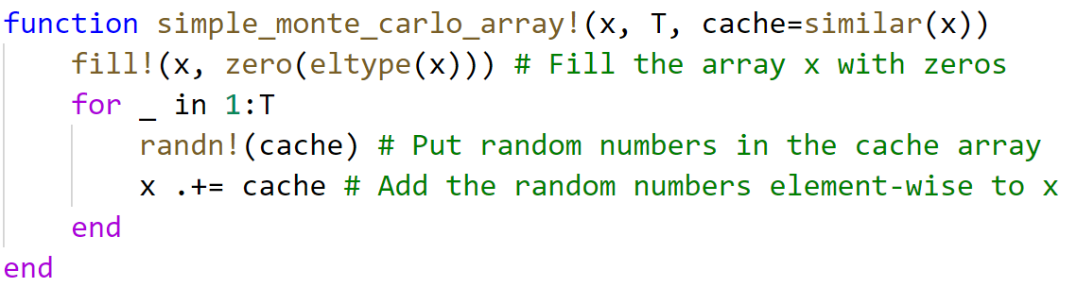
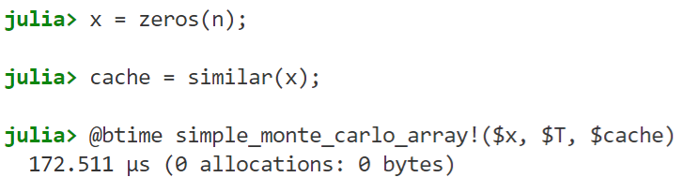
What about “vectorisation”?
~1.8 times faster (single core)

Slide 8
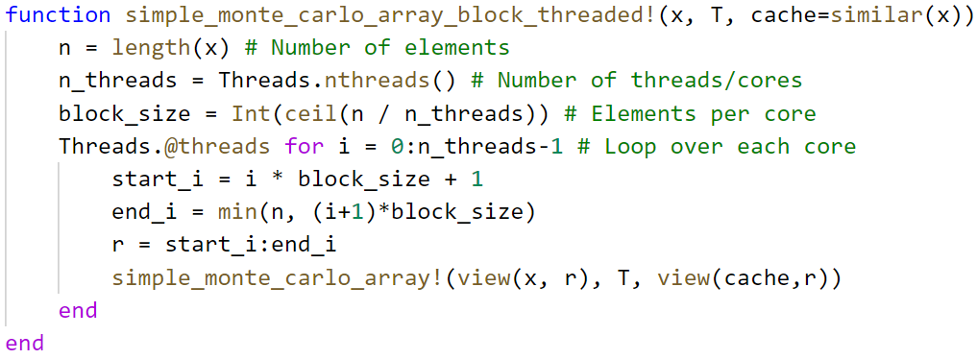

Using multiple cores
Each core can process a subset of the total array
Core 1
Core 2
$$⋯$$
Core 7
Core 8
Write some code to calculate the start and end indices of a chunk and parallelise with @threads macro.

Slide 9
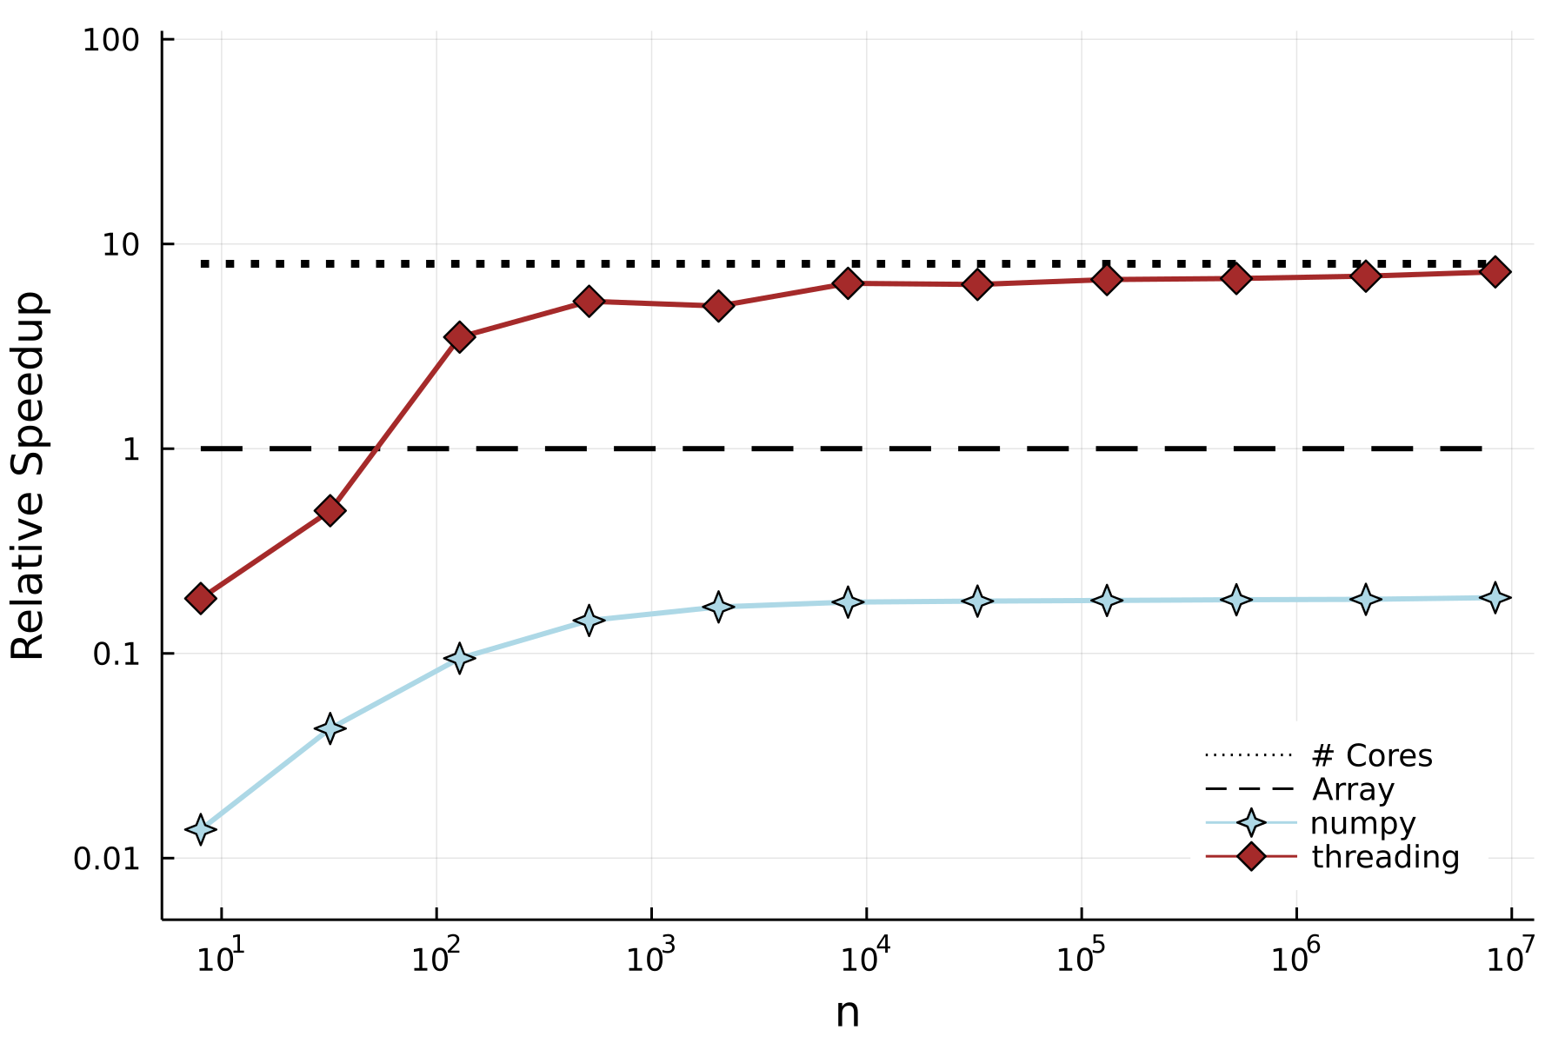
Relative Performance
~5.3x slower

Slide 10

Using a GPU
Same “vectorised” code as before
Only the input types changed, and Julia compiled a GPU version of the function.
Just the surface of using CUDA.jl – one can write custom kernels in native Julia!

Slide 11
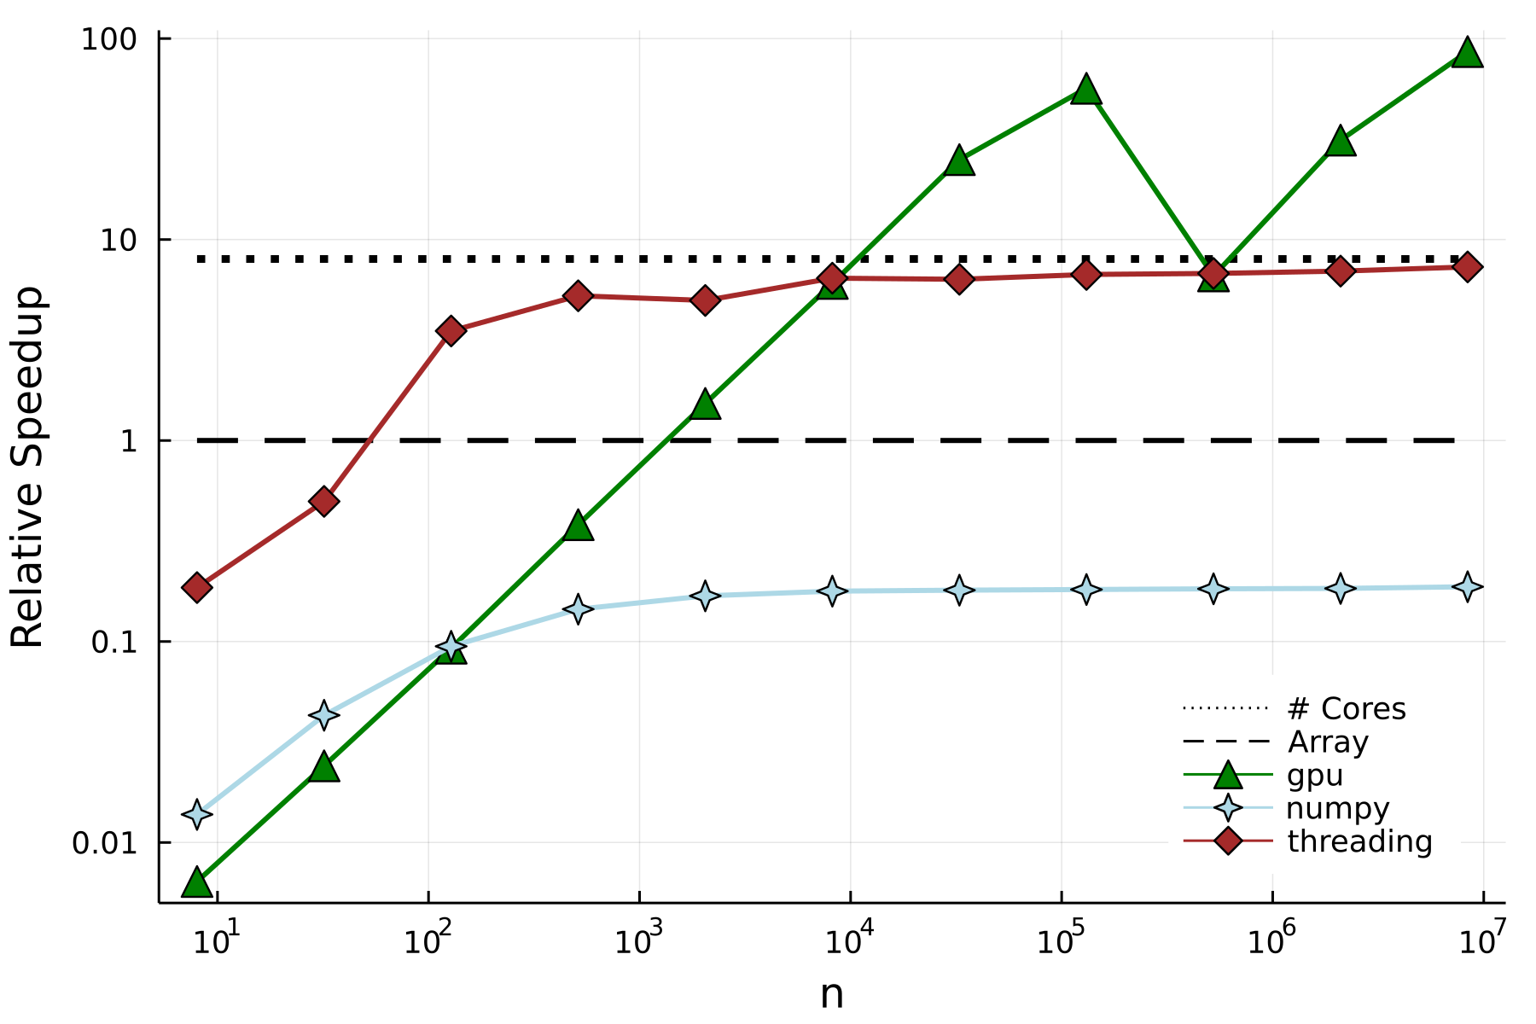
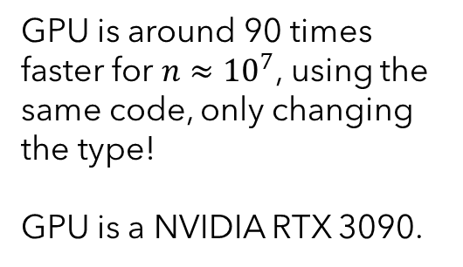
Relative Performance
GPU is around 90 times faster for $n≈{10}^{7}$, using the same code, only changing the type!
GPU is a NVIDIA RTX 3090.

Slide 12
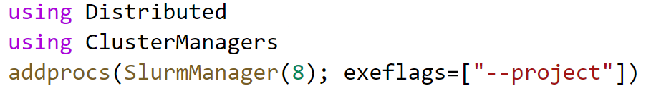
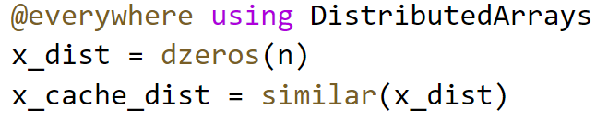
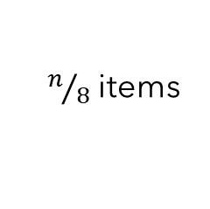

Moving to a cluster
Worker 1
Worker 2
$$⋯$$
Worker 7
Worker 8
Array is split up into 8 parts, one for each worker process.
$n/8$ items
* Requires some additional boilerplate code

Slide 13
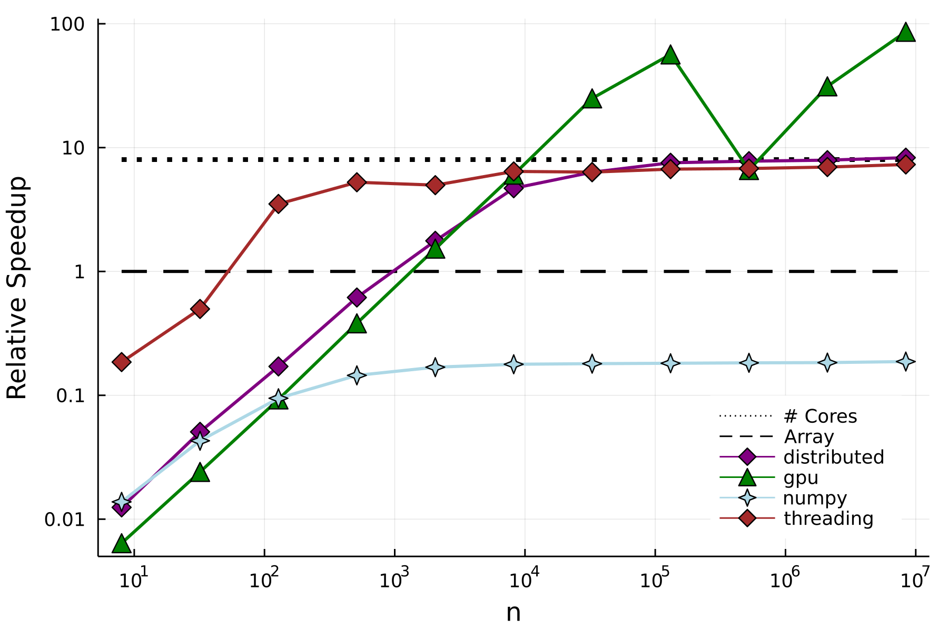
Final Benchmarks
Distributed implementation approaches maximum speedup, as it follows the same chunk approach as the threaded blocks.

Slide 14
Conclusions
Julia is a fast language, suitable for numerical computing
Has great, lower barrier-to-entry, support for parallel computing at all levels
Compiler specialised on types allows for high-performance and reusable generic code
Is easy to write, prototype and understand!

Slide 15

Thanks for listening!
All code available at https://github.com/JamieMair/julia-for-research-with-hpc
If you want access to the Julia lecture notes, email me at jamie.mair@nottingham.ac.uk
Any questions?

Slide 16
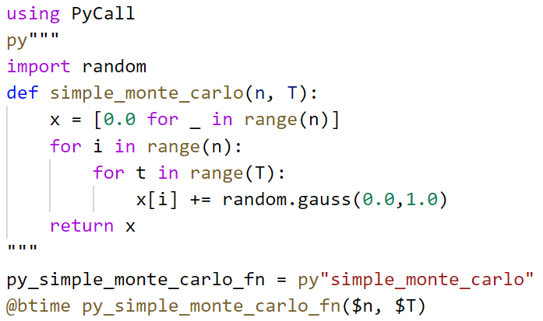

Is it fast? (vs native Python)
~150 times faster****

Slide 17
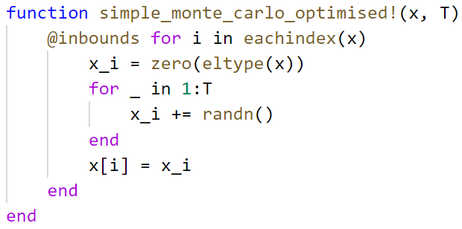
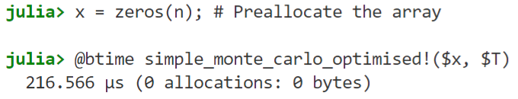
Can it be faster?
Do not create a new array, mutate an existing one
Turn off bounds checking
~1.4x faster

Slide 18

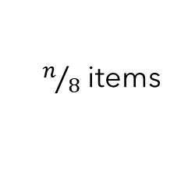

Scaling up to a cluster
On a SLURM cluster
Worker 1
Worker 2
$$⋯$$
Worker 7
Worker 8
Array is split up into 8 parts, one for each worker process.
$n/8$ items

Slide 19
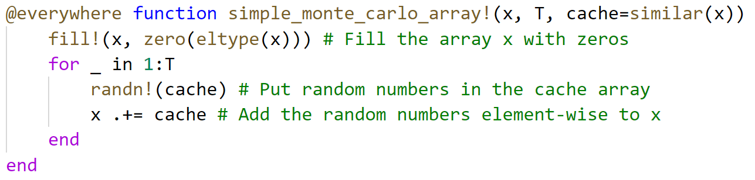
Scaling up to a cluster
1) Make all functions available to each worker, using the @everywhere macro

Slide 20
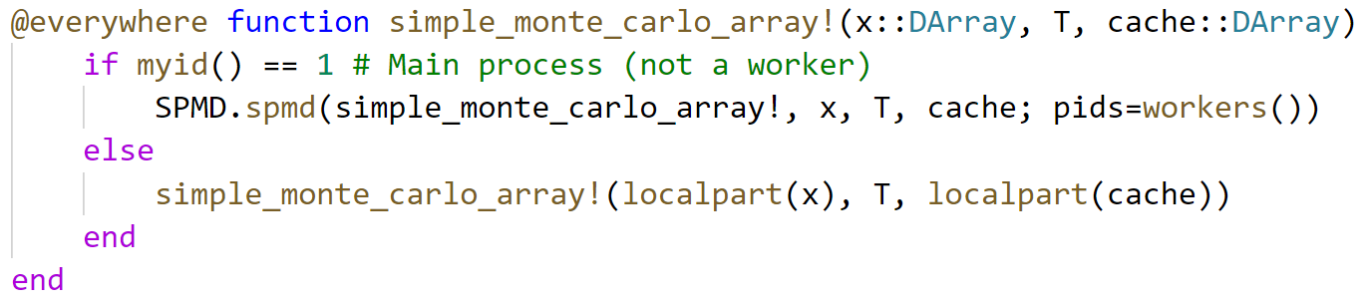
Scaling up to a cluster
2) Specialise on the DArray type, with some boilerplate for Single Program Multiple Data. Lifted from the DistributedArrays.jl documentation.
This code runs our standard array function on each local part of the distributed array. This only affects the function when using DArray datatypes.

Slide 21
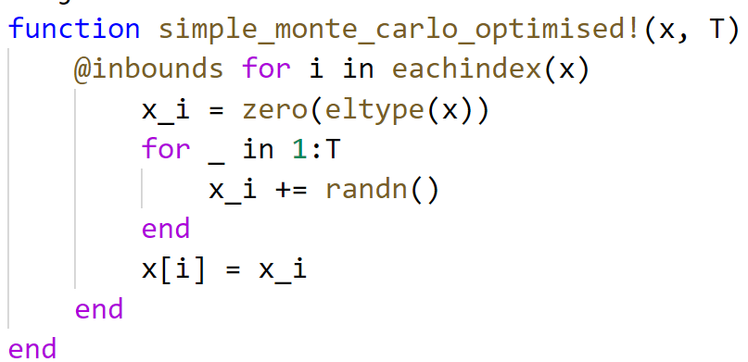
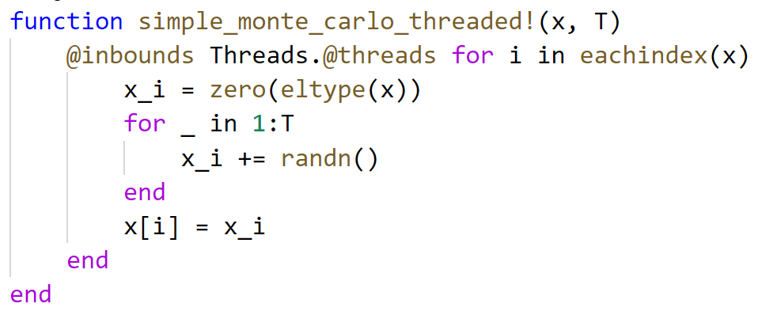

Using multiple cores
~4.7 times faster, using 8 cores

